Slide 1

EF Core Getting started with Tokidokis

Slide 2

This ppt has been sweetening with tokidokis
¡Attention!

Slide 3

In this ppt no tokidokis have been mistreated
Advertising

Slide 4

Eric Torre
Microsoft Consultant
Eric.Torre@Tokiota.com
@etorregc

Slide 5
1
2
3
Concepts
Configuring
New features
Why EF
EF Types
Nuget
Context
Entities
Add to startup
Mappings
AppSettings
Creating migrations
Applying migrations
Initialize data
Shadow properties
Calculated properties
4

Slide 6


Concepts
Mapping db tables to class objects
Db maintenance with migrations
Seed data
Easy to CRUD operations app
Sql queries not needed
Works with different DBs
Why EF

Slide 7

Concepts
DB First
Code First
EF Types

Slide 8

Microsoft.EntityFrameworkCore
Microsoft.EntityFrameworkCore.Design
Microsoft.EntityFrameworkCore.Relational
Microsoft.EntityFrameworkCore.SqlServer
Tooling:
Microsoft.EntityFrameworkCore.Tools
Microsoft.EntityFrameworkCore.Tools.DotNet XXX
Testing:
Microsoft.EntityFrameworkCore.InMemory
Configuring
Nuget

Slide 9

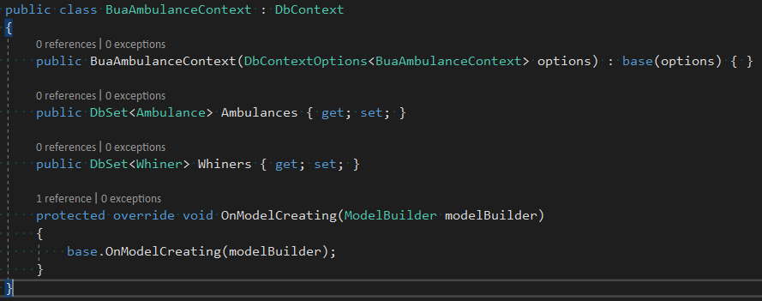
Configuring
The “tables” (false) that we need to work
Context

Slide 10
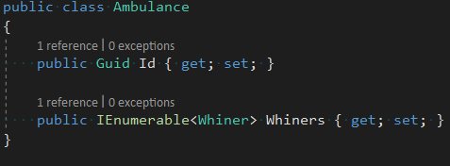

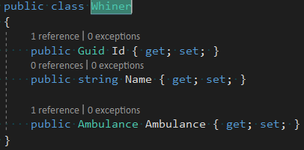
Configuring
Representation of “tables” (or parts) in .cs files
Entities

Slide 11

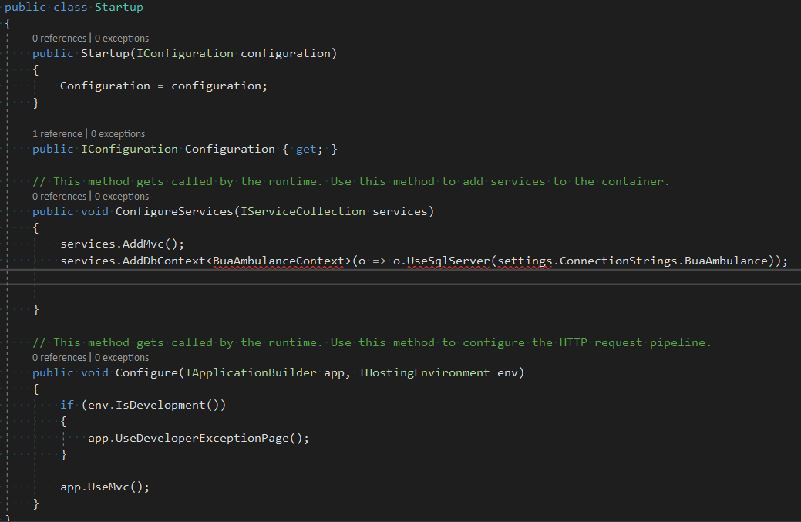
Configuring
Representation of “tables” (or parts) in .cs files
(Move config)
Add to startup

Slide 12


Slide 13

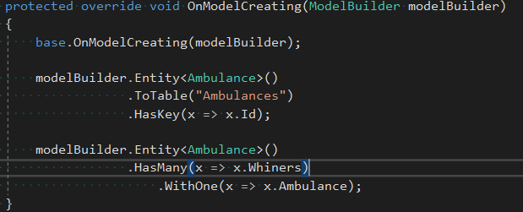
Configuring
Add keys
Add relations
Modify properties
…
Mappings

Slide 14
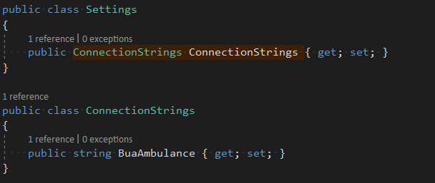

Configuring
Need to add connectionstring
Settings Object
AppSettings

Slide 15

Configuring
Generate DB
Generate migrations with changes of db
dotnet ef migrations
add InitialBuaAmbulance
-c EF.Core.Contexts.Contexts.BuaAmbulanceContext
-o ../../Data/EF.Core.Contexts/Migrations/BuaAmbulance
-p ../../Data/EF.Core.Contexts/
Migration file
Can modify the migration
Creating
migrations

Slide 16

Configuring
First time, blank database is needed
dotnet ef
database update
-c EF.Core.Contexts.Contexts.BuaAmbulanceContext
-p ../../Data/EF.Core.Contexts/
Model snapshot
Migration file
Applying
migrations

Slide 17
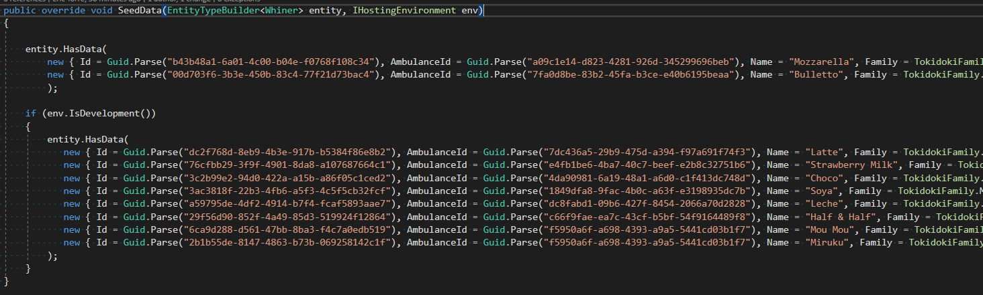

New Features
Initialize data

Slide 18
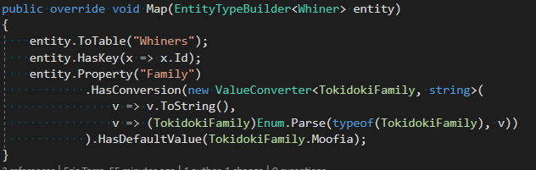

New Features
Value converters

Slide 19
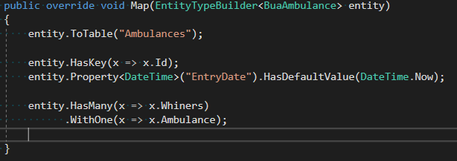

New Features
Shadow properties

